Slide 1
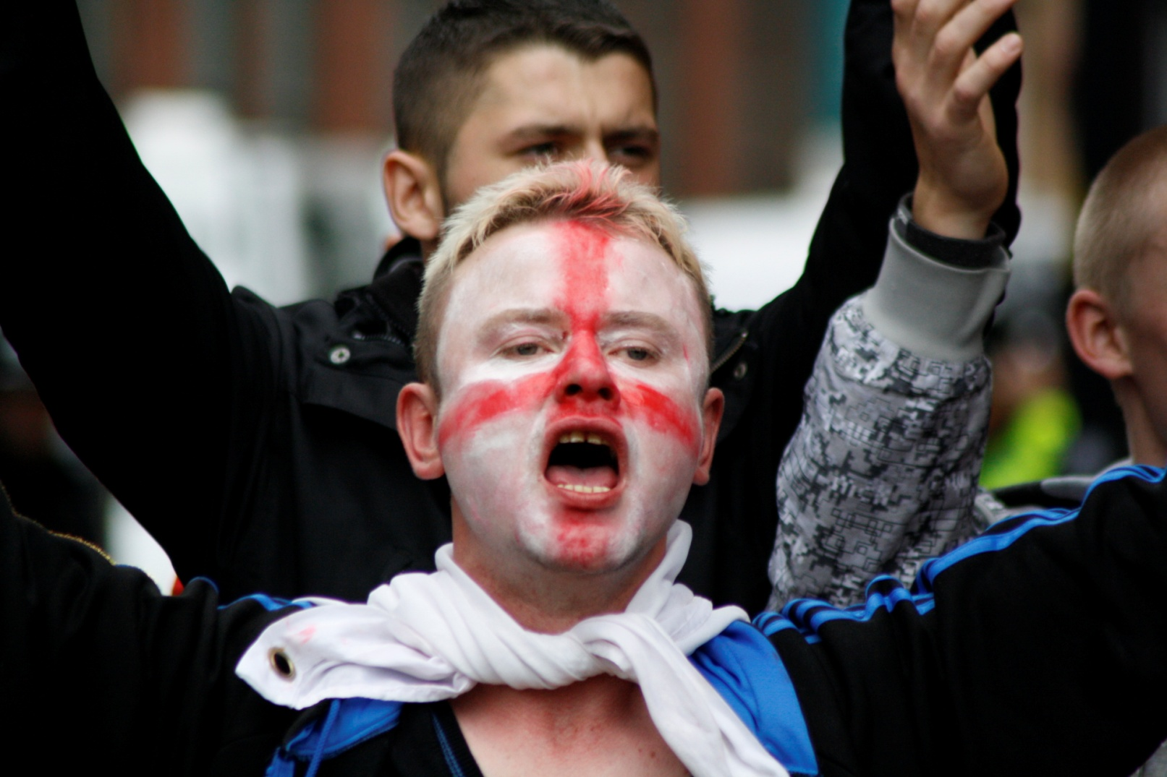
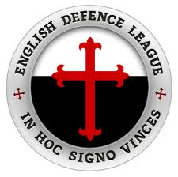
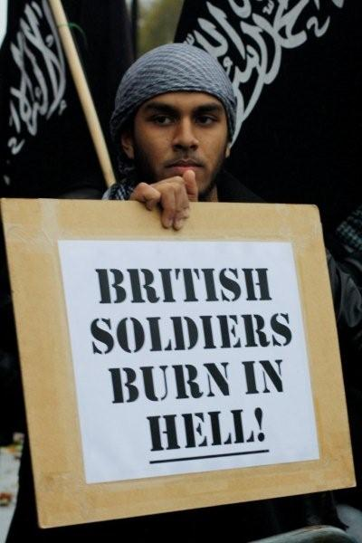
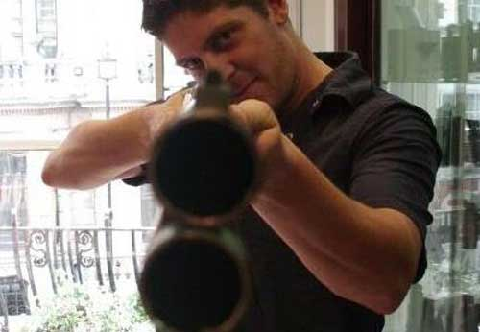
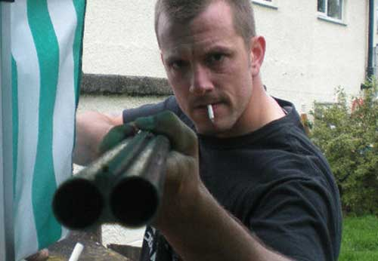
From Defence to Attack
The Growth of The English Defence League

Slide 2
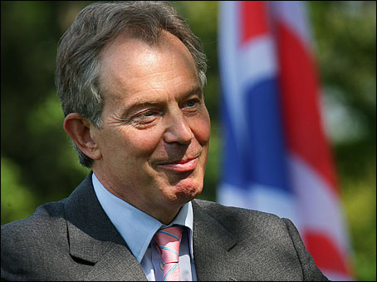
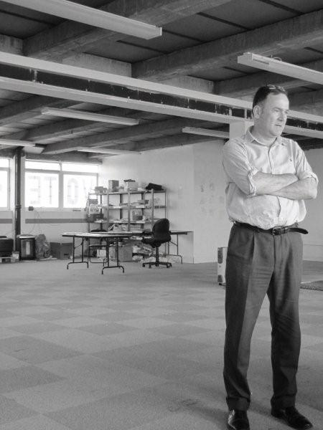
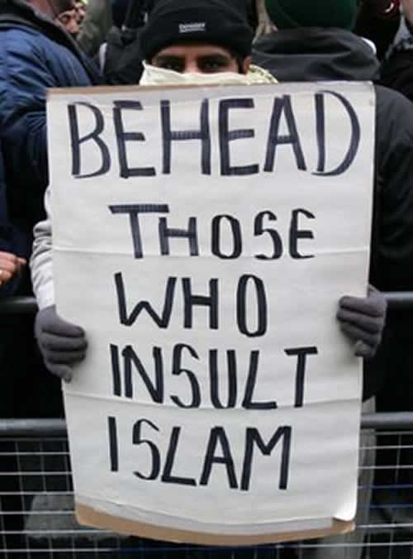
The interesting thing about Labour at its best, compared with other forms of European social democracy, was that it didn’t have a specific denomination and wasn’t specifically secular.
You can see the way it is being reframed now across Western market economies, with the whole thing about ‘the other’ - the other constituency being Islam. I think it’s going to be quite dangerous and brittle and uncomfortable for years, besides the consequences of these economic cuts and, you know, the coarsening of the language, the demonisation of the weak and vulnerable. The whole of our culture will be affected by it, in an as yet unpred­ictable way. I’m not awash with optimism, I’m afraid.
Jon Cruddas, Speaking to ‘Third Way’ (Christian Comment on Culture) Jan 2011

Slide 3
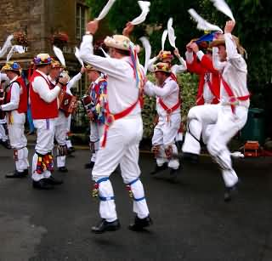
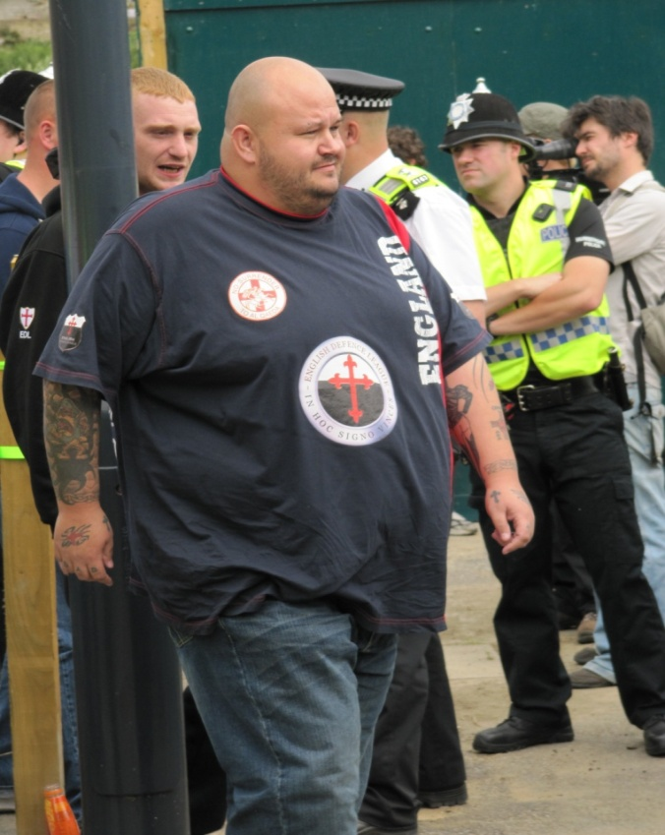

Slide 4
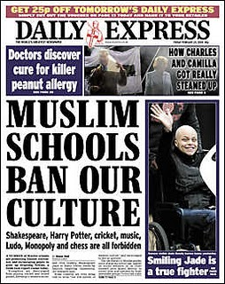
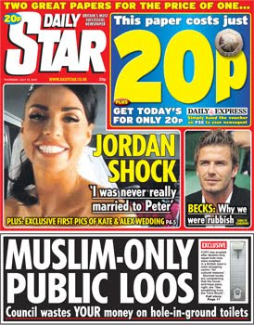
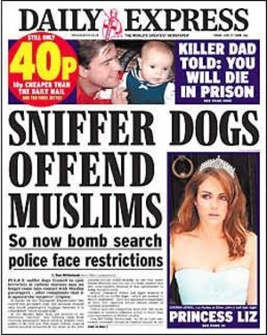
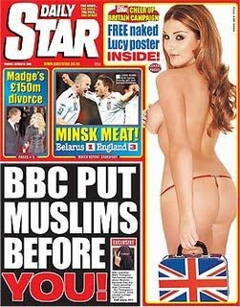

Slide 5
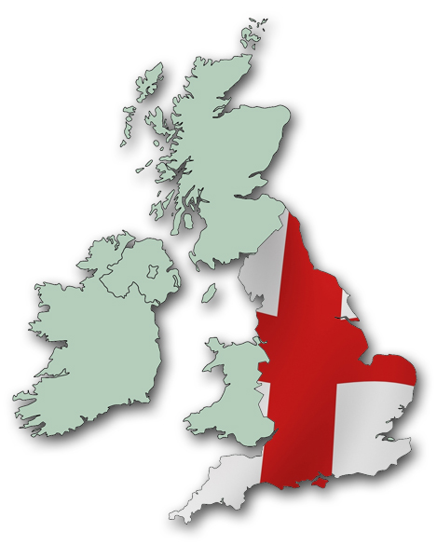
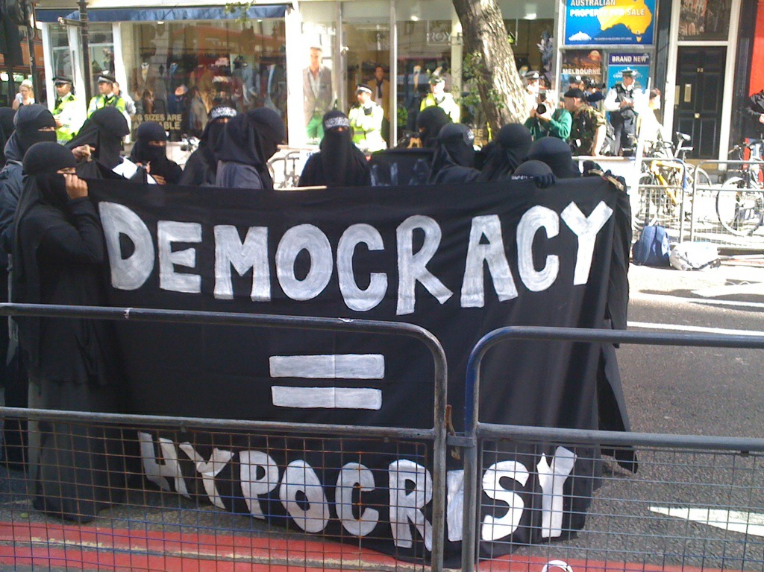

Slide 6
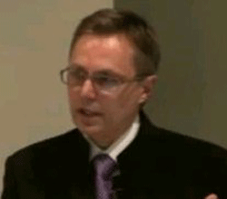
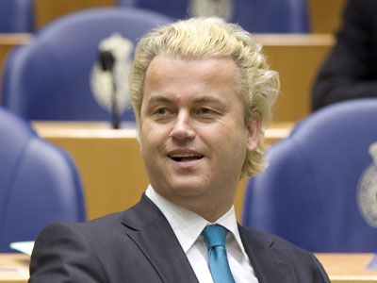
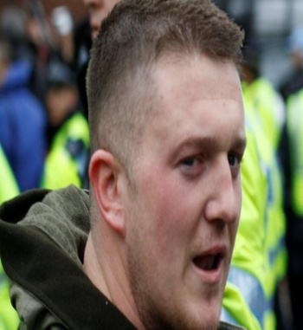
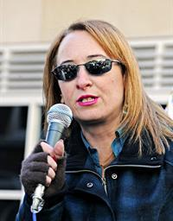
Stop Islamization of America - Four Freedoms/Alan Lake - Stop Islamisation of Europe
Pakistani Christian Association
March for England
Unite British Alliance
Casuals United
Jewish Task Force/Jewish Defence League
United Kingdom Independence Party
English Democratic Party
Vérité, valeurs & Démocratie
Citizens Movement Pax Europe
European Freedom Initiative
Minuteman Project/Minutemen
Militias
Pam Geller
Tea Parties
Jewish Task Force/Jewish Defence League
“Alan Lake”
Geert Wilders Pam Geller Stephen Yaxley Lennon Roberta Moore
“We’re looking to football fans. We need people who are
out on the streets”.

Slide 7
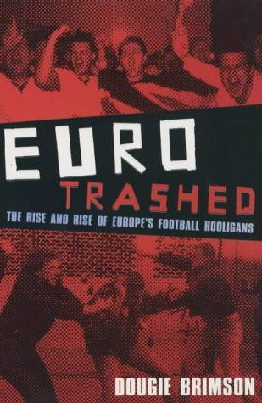
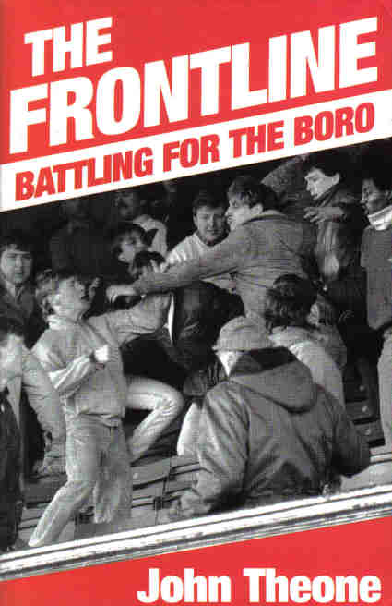

Slide 8
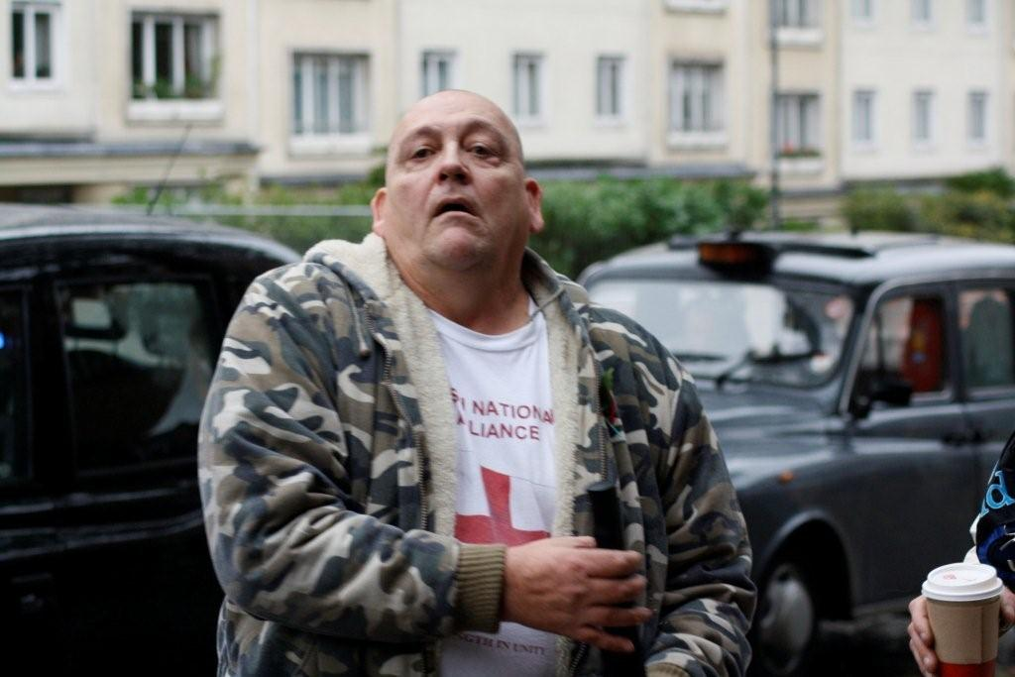
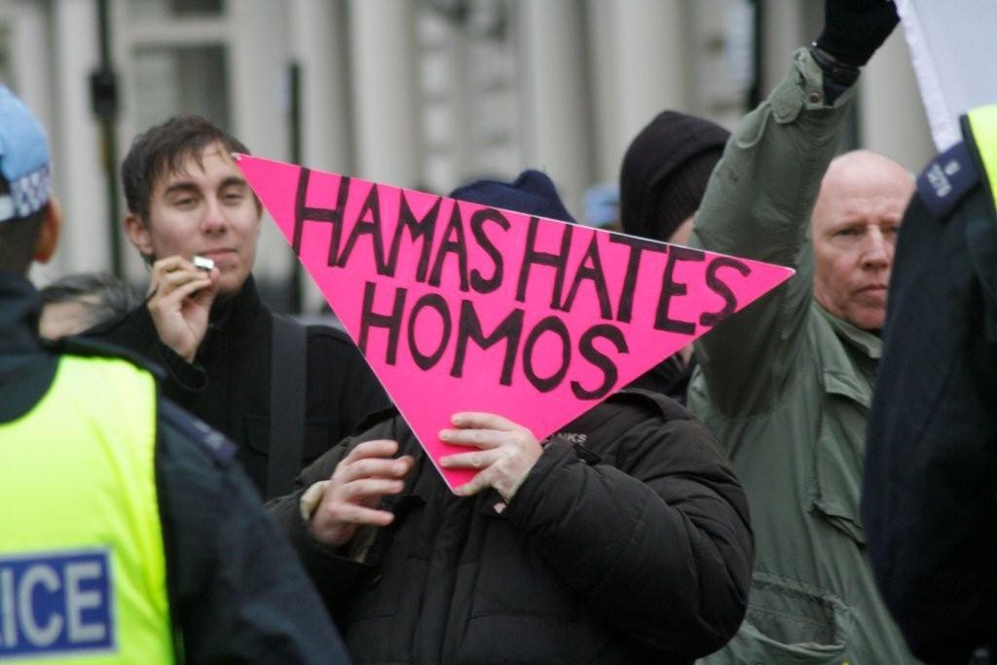
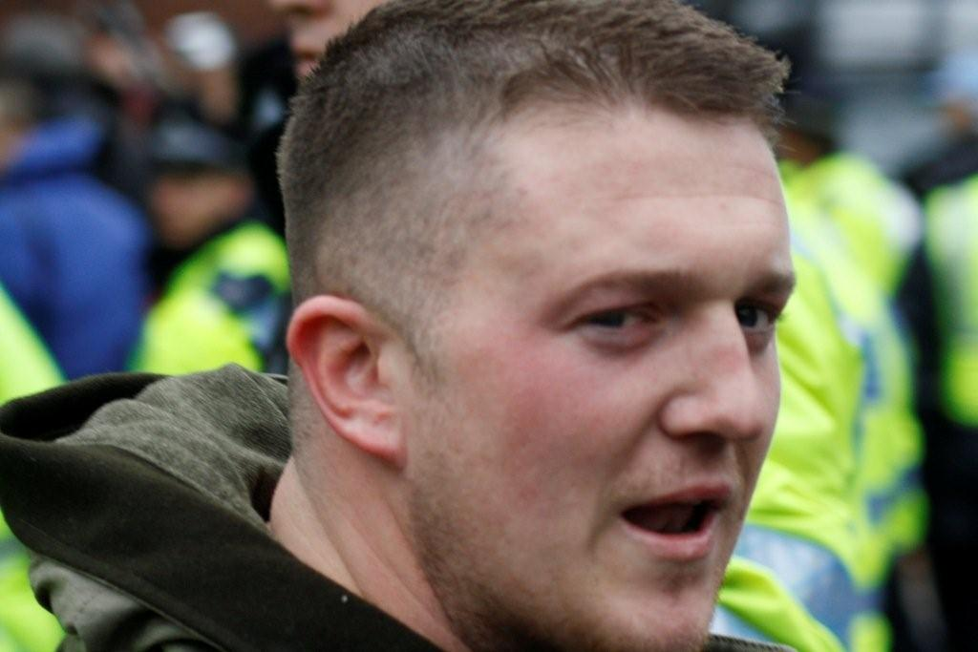
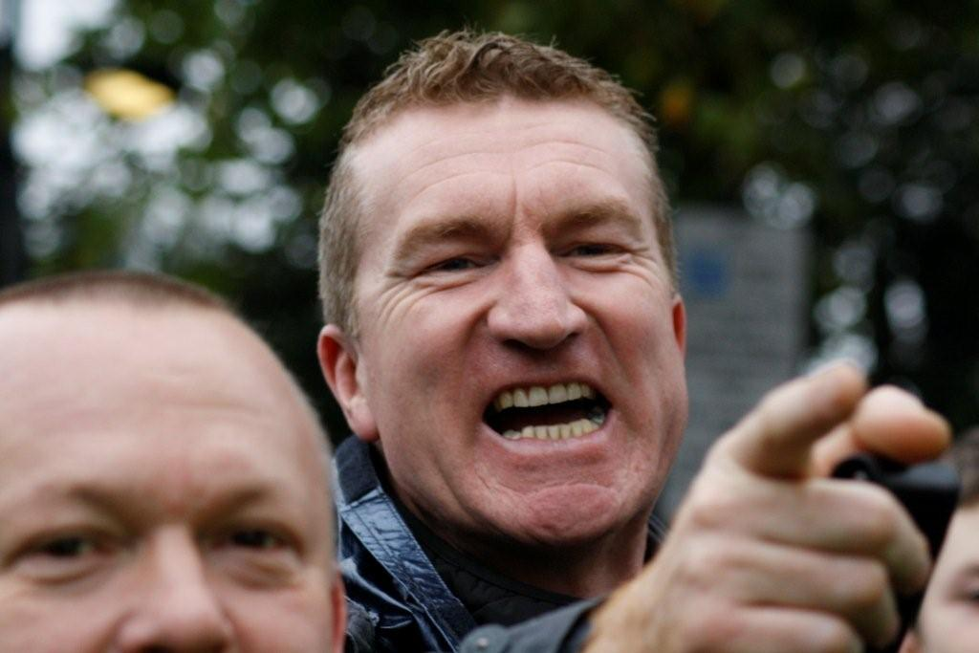
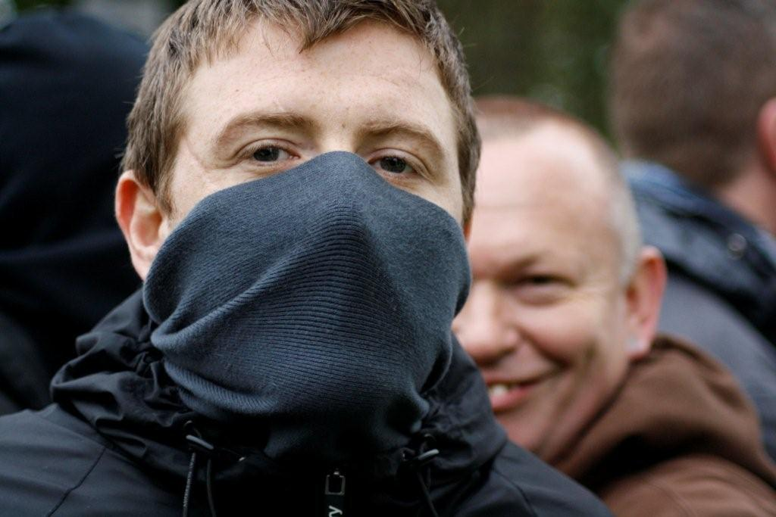
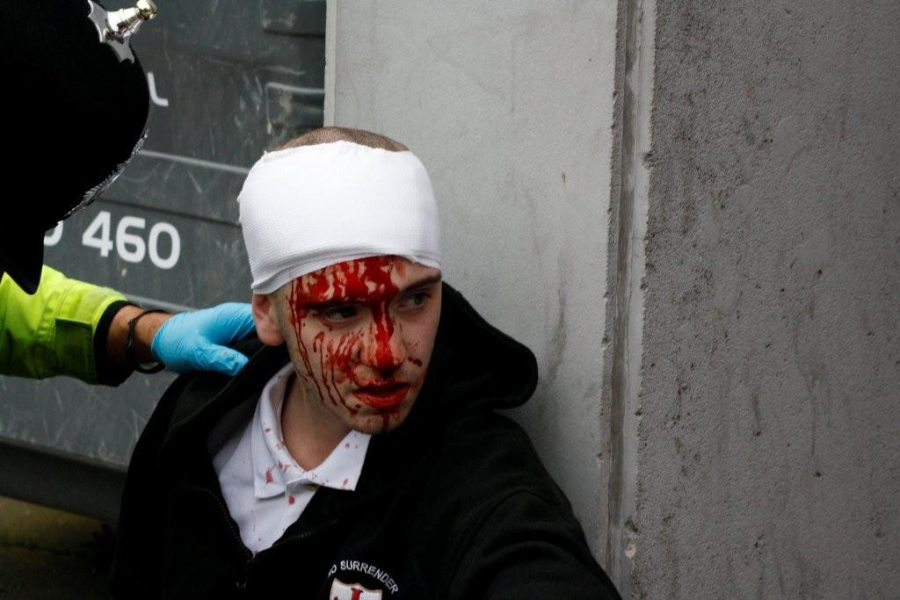

Slide 9
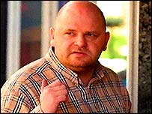
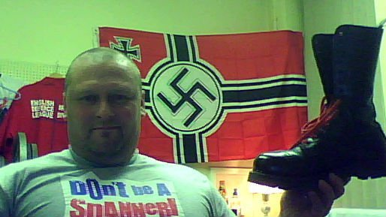
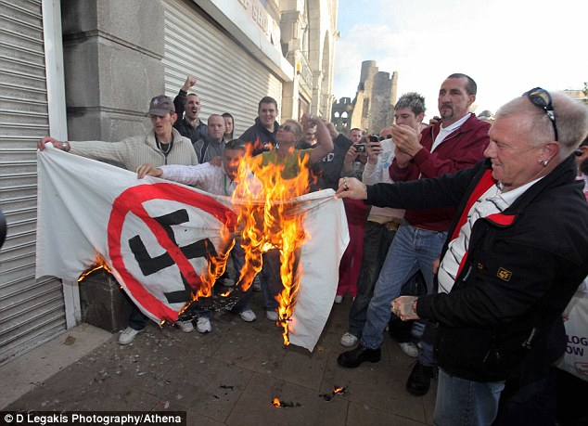
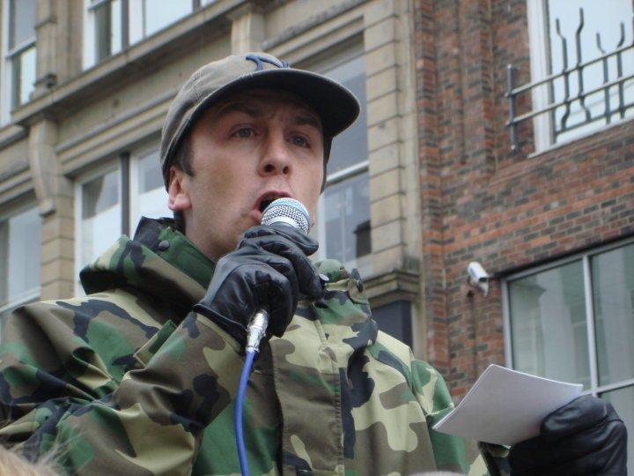
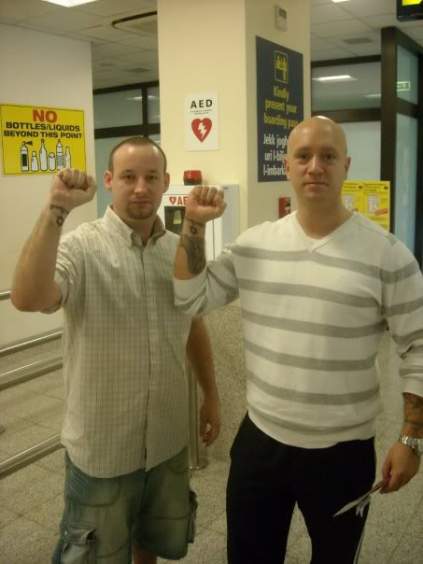
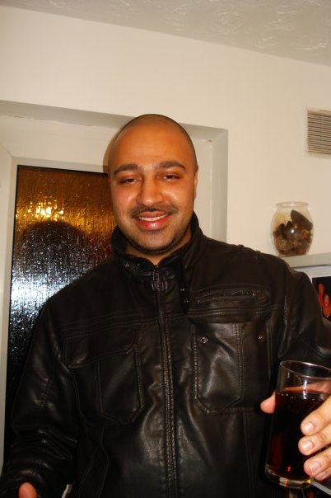
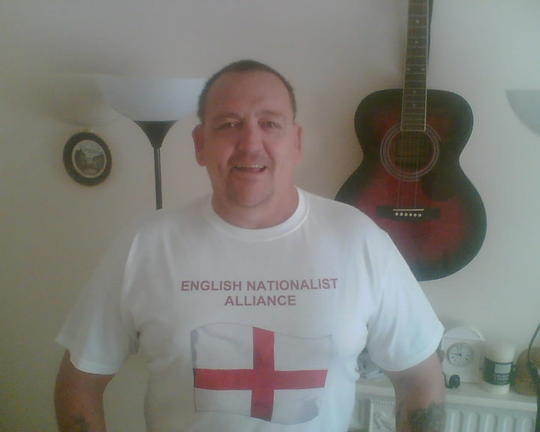
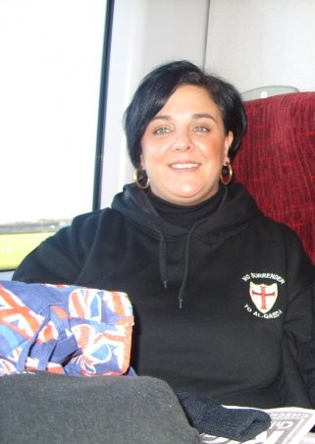

Slide 10
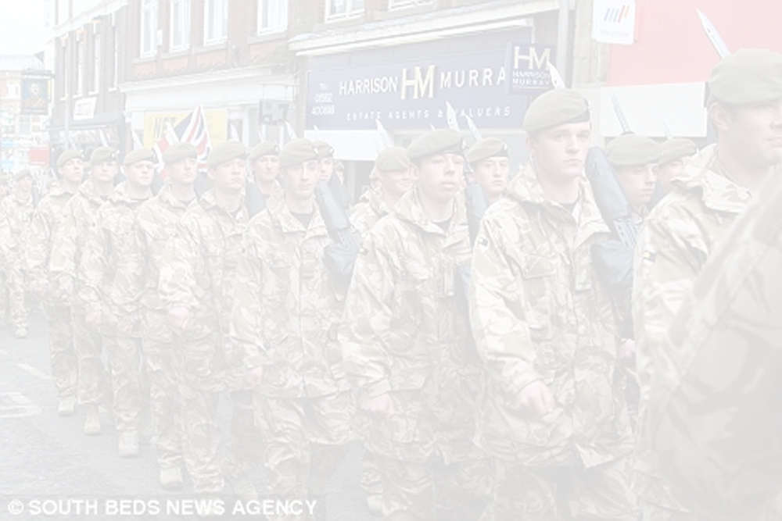
EDL Time Line
2009
Mar British troops from the Royal Anglian Regiment attacked verbally on homecoming march in Luton
Apr "United People of Luton" formed to protect the next home coming parade.
Jun UPL merges to become part of the "English Defence League"
Jul 50 EDL members hold a drunken protest in Birmingham
Jul 30 Unite Against Fascism/Socialist Workers Party protest in Birmingham city centre
Aug 200 EDL clash in Birmingham city centre with 400 SWP/UAF 35 arrested
Sep 500 EDL clash in Birmingahm city centre with 300 SWP/UAF 90 arrested
Oct 700 EDL & 1400 UAF/SWP demonstrate in Manchester 48 arrested
Further clashes in Leeds and London
Nov Break for "internals"
Dec Clashes after military marches in Nottingham & London 9 arrested
2010
Jan 1500 EDL clash with police in Stoke (300 UAF) 17 arrested
Mar 500 EDL march in London in support of visitng Dutch MP Geert Wilders
100 UAF counter protest 7 arrested
2000 EDL clash in Bolton during protests. (1500 UAF) 74 arrested
EDL leaders attened meeting and rally in Copenhagen
Apr 2000 EDL Dudley (1500 UAF) 12 arrested
May 800 EDL Aylesbury (75 UAF) 12 arrested
1500 EDL Newcastle (1000 UAF) 0 arrested
Jul 500 Dudley (300 UAF) 21 arrested
Aug 700 (Bradford) (300 UAF) 13 arrested

Slide 12
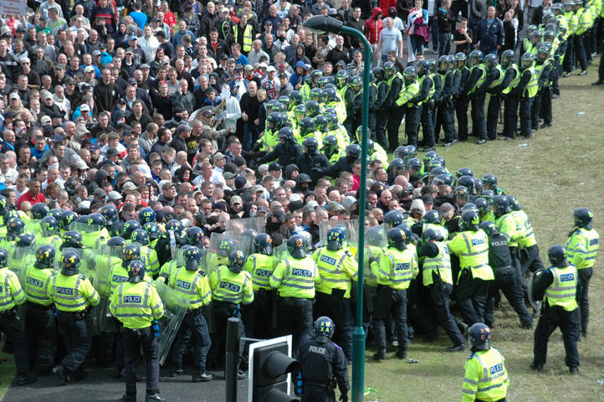
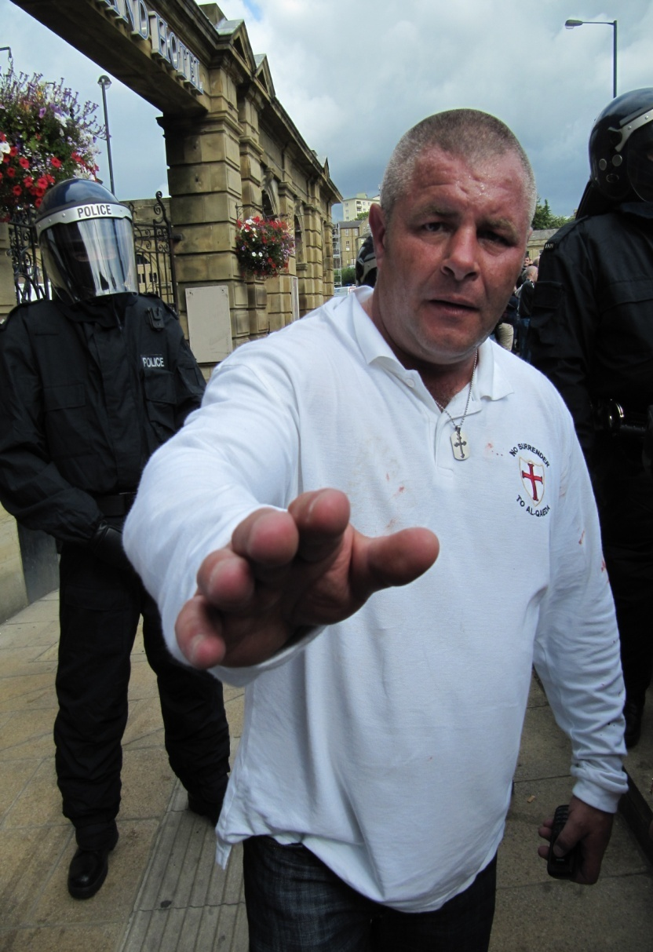
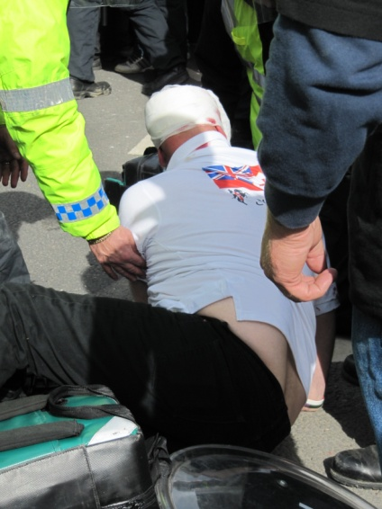
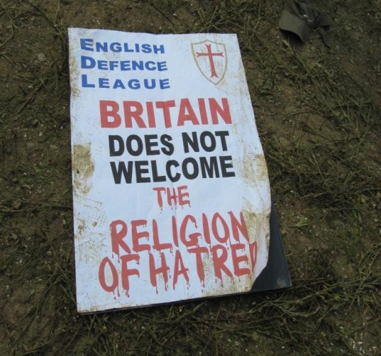

Slide 13
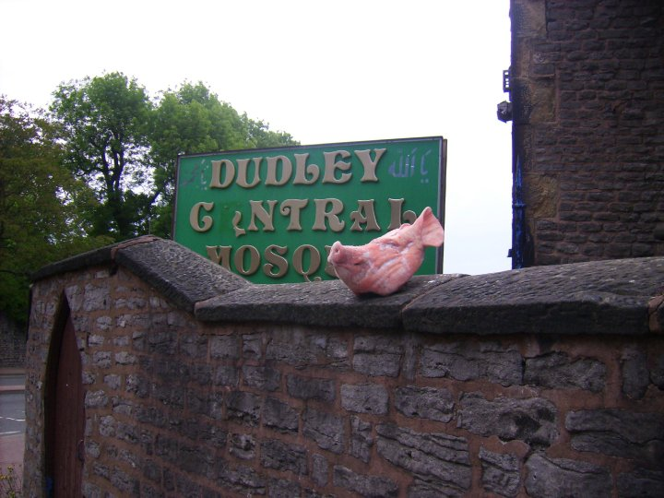

Slide 14
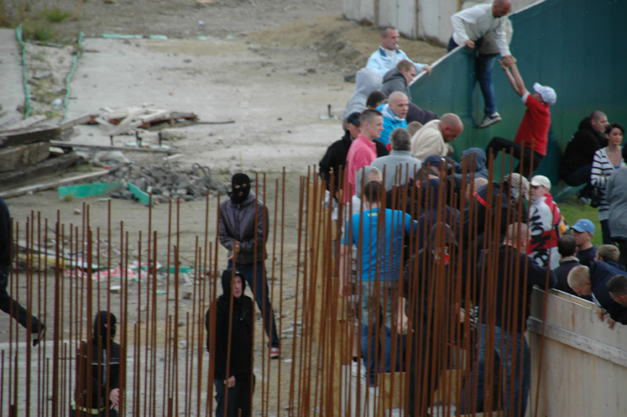

Slide 15
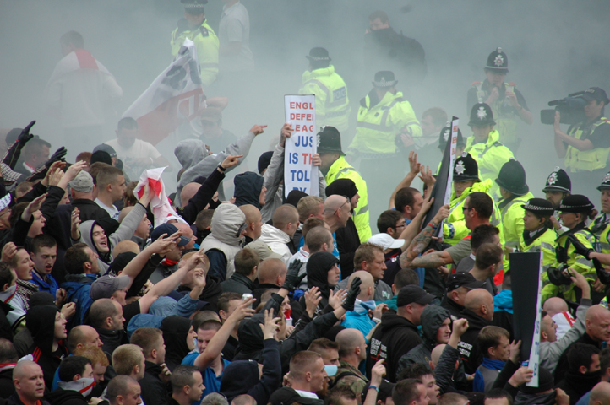

Slide 16
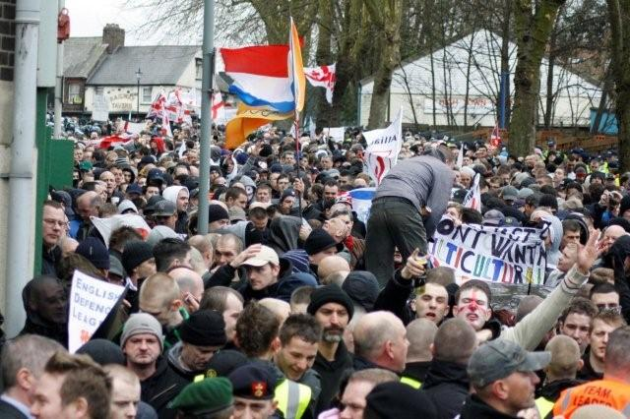
A “Fringe” Movement?
90,000 Facebook Members*
3 Full time staff
1500 “Active” members
11,000 Forum Members
24 Regional Organisers
LGBT, women’s, Youth & Jewish ‘Divisions’.
International Divisions:
Germany, Holland, Norway, Belgium,
Denmark, Wales, France, Scotland,
Australia, Sweden.

Slide 17
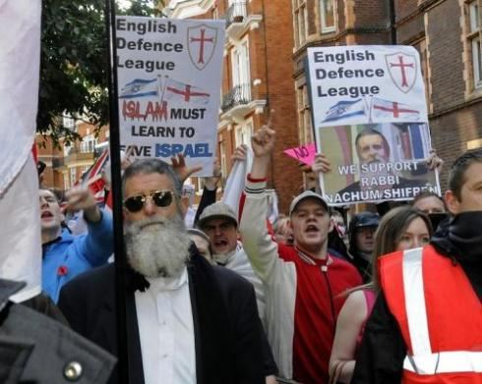
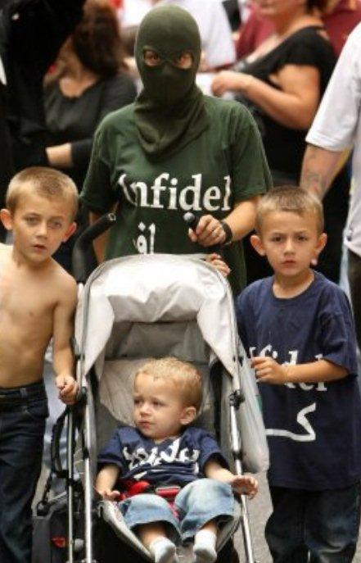
A Directionless Movement?
Against Racism
Anti-Nazi
Anti-Communist
Against anti-Semitism
Pro-Israel
Anti- Islamist
Anti-Sharia
Anti-Burka/Hijab
Against Halal
Anti-Abortion &
Pro-Choice!
Pro-Gay Rights
Pro-America
Against Muslim Immigration
Anti-Mosque

Slide 18
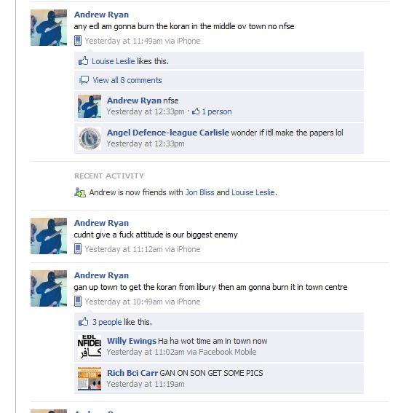
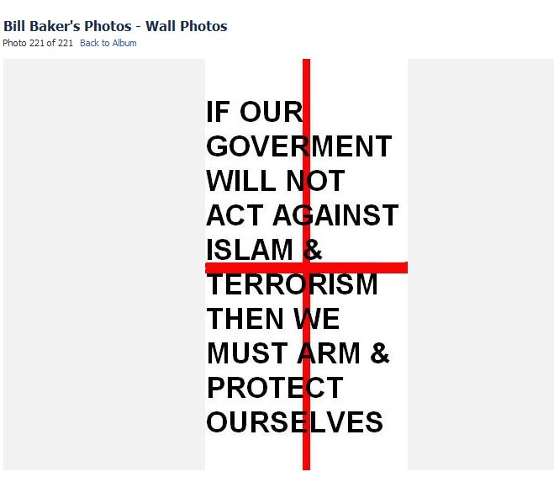

Slide 19
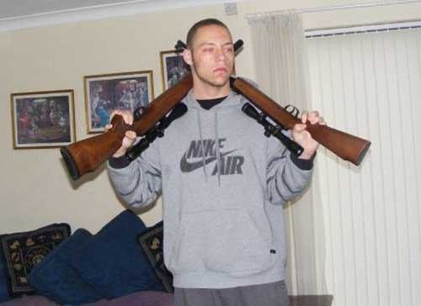

Slide 20
EDL Protest March, East London June 2011

Slide 25
The Inspiration and the “spark”
“We’re about five years away from one of our kids going and blowing themselves up out of frustration, too”. Stephen Yaxley Lennon Feb 2011
The EDL (2009) The “Infidels” (2011) “CXF” (2011)

