Slide 1
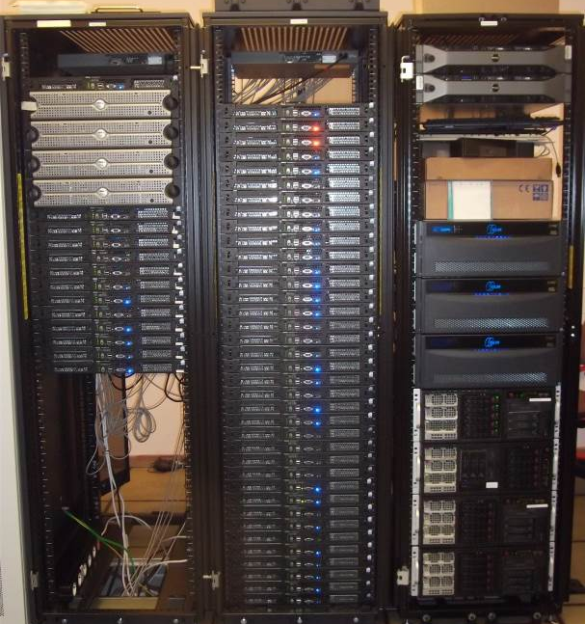
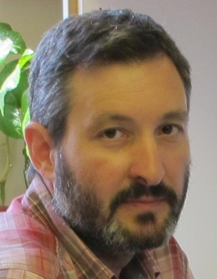
Big Data Analytics
András Benczúr
benczur@sztaki.mta.hu
Head,
“Big Data – Momentum”
Research Group
in collaboration with
Volker Markl
TU Berlin
Institute for Computer Science and Control,
Hungarian Academy of Sciences
http://datamining.sztaki.hu/
Notes:
The Research Institute of Computer Science and Control of the Hungarian
Academy of Sciences participates in ICT Labs as partner of Eötvös University
Budapest.
The participating team leverages on our colocation and mobility with
universities and industry in Infopark Budapest. We supervise thesis
projects and instruct regular courses (Technical University and Eötvös
University; algorithms, data mining, Web information retrieval). As
research partners, we are involved in several Digital Libraries, Future
Internet and Security ICT projects that give us opportunity to involve and
train university students. Our industrial contacts include the Hungarian
Telecom Group and AEGON Hungary where technologies are deployed.
In the presentation, with our projects as examples I will illustrate how we
cover the knowledge triangle for handling very large scale data with
applications in the areas of networks, user and content interaction,
financial and inland security, business intelligence, data and text mining.

Slide 2
Data Management vs. Data Analytics
Data Management for traditional gather, access, search
Analytics (Machine Learning) for insights, predictions

Slide 3
Deep Analytics needs

Slide 4
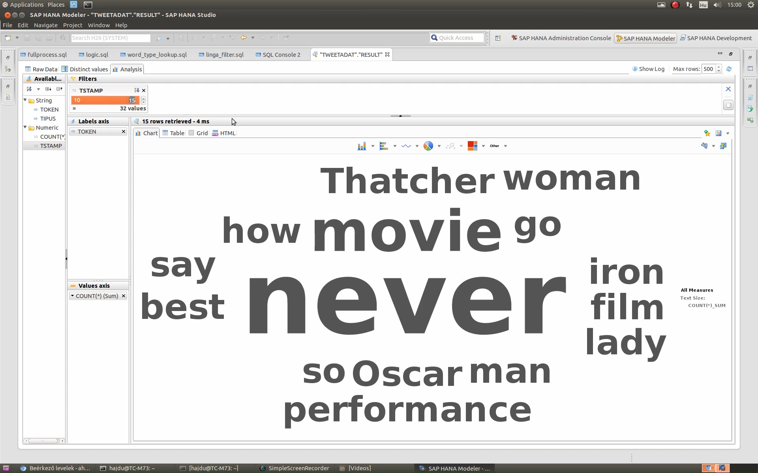
Twitter Example: Meryl Streep – Oscar, 2012

Slide 5
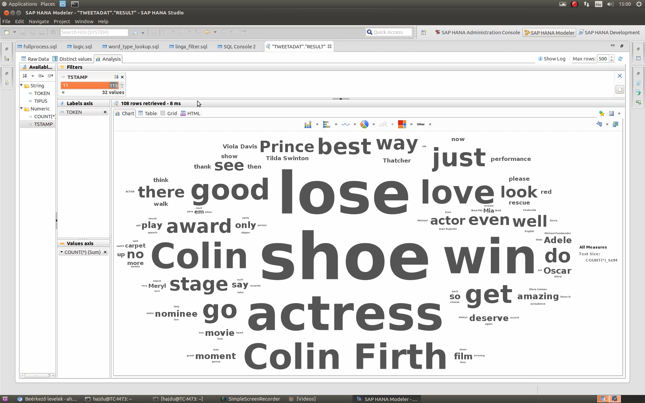
Twitter Example: Meryl Streep – Oscar, 2012

Slide 6
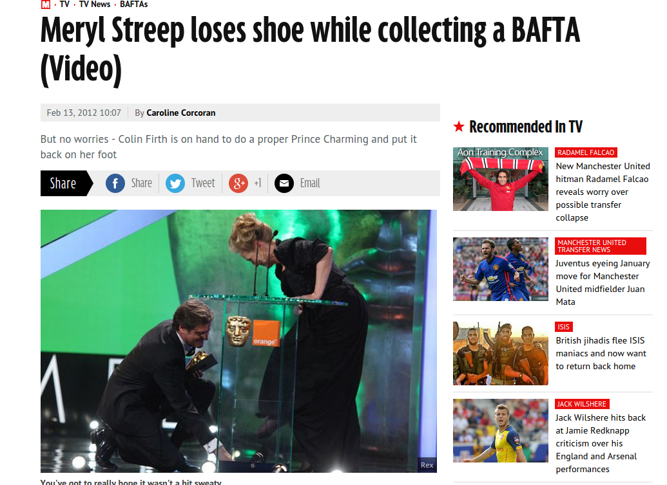
Twitter Example: Meryl Streep – Oscar, 2012
kép: http://mirror.co.uk

Slide 7
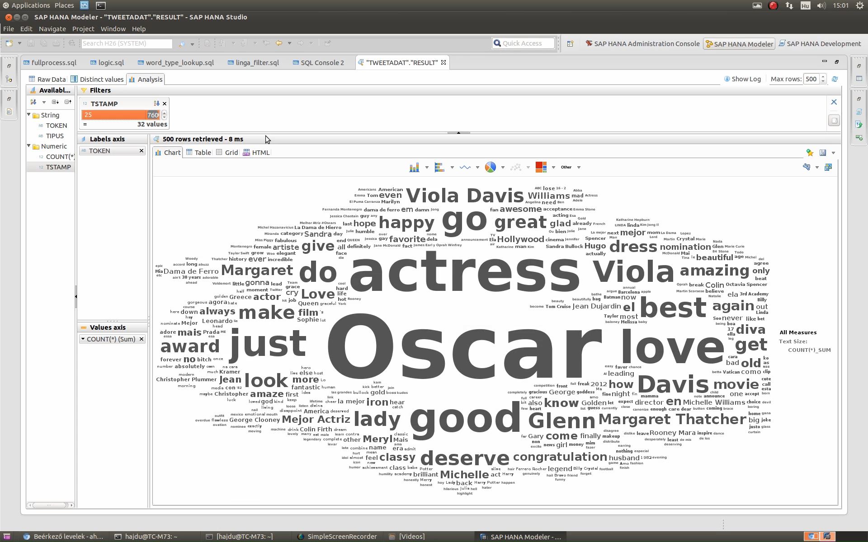
Twitter Example: Meryl Streep – Oscar, 2012

Slide 8
Twitter Example: Meryl Streep – Oscar, 2012
kép: http://bbc.com

Slide 9
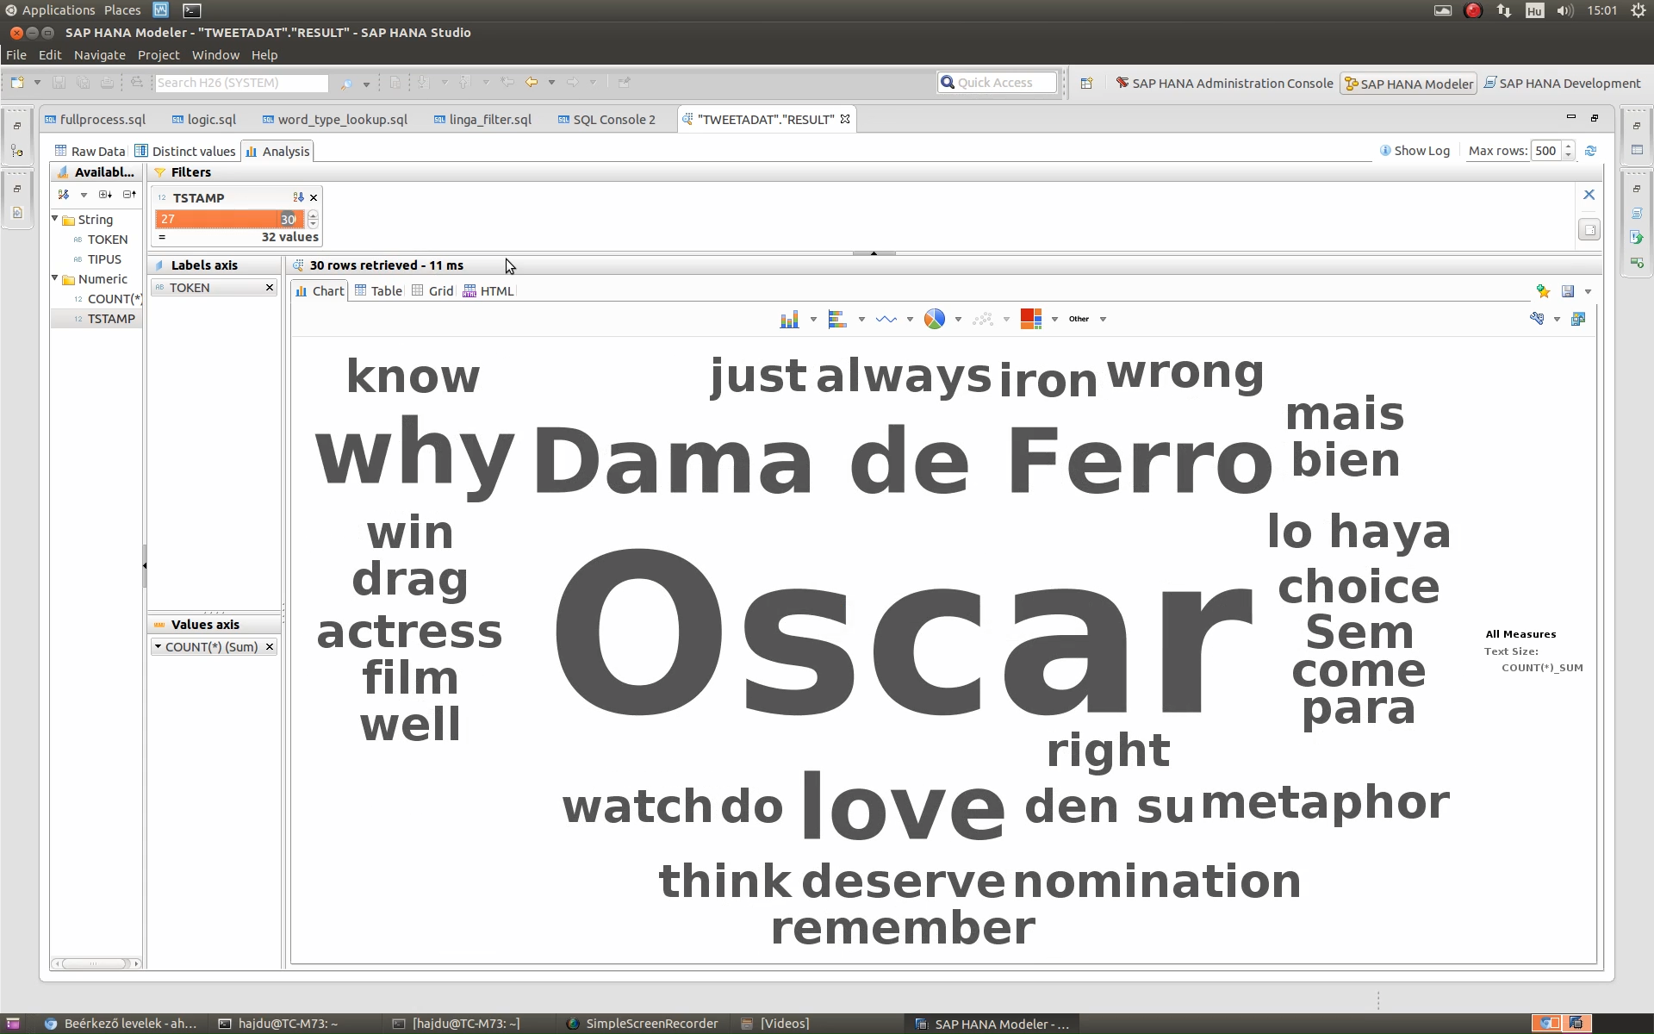
Twitter Example: Meryl Streep – Oscar, 2012

Slide 10
What was The Analytics Challenge?
One year 1 billion Tweet collection, 100GB
Ad Hoc queries (Meryl Streep) may have 100,000+ hits
Fast response needed to support the analyst
Solutions
In Memory databases (SAP HANA, …) – cost and physical limitations
Customized approximate data structures (Bloom filters, MinHash fingerprints)

Slide 11
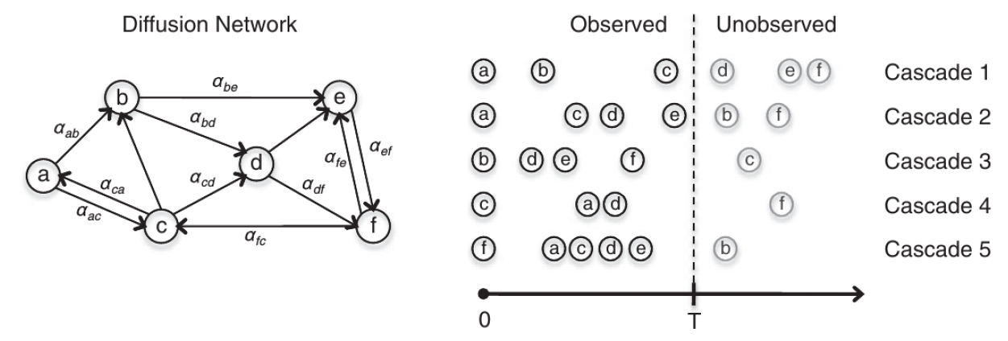
Need for Networked Analytics

Slide 12
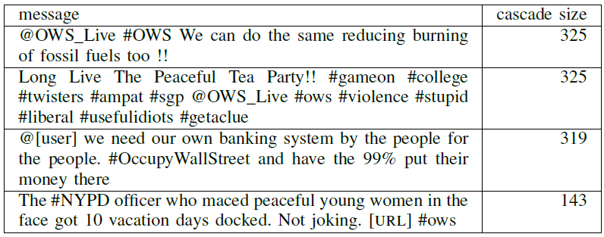
Need for Networked Analytics
Information in interconnectivity
Number and influnce, impressibility of followers, tweets
Statistical properties on temporal dynamics and number of users reached by messages

Slide 13
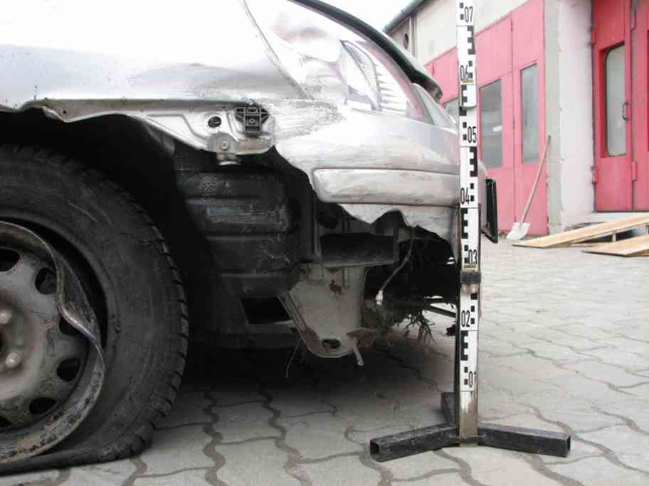
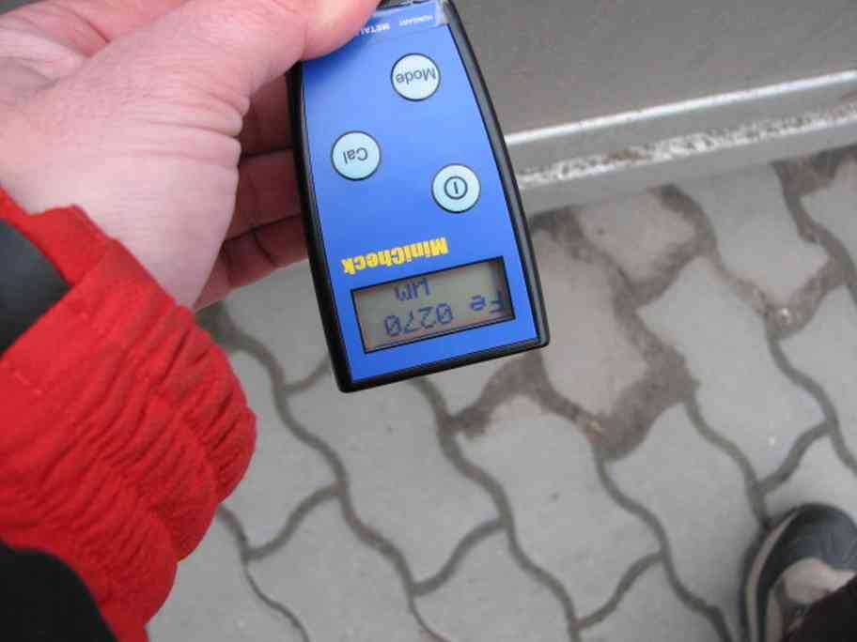
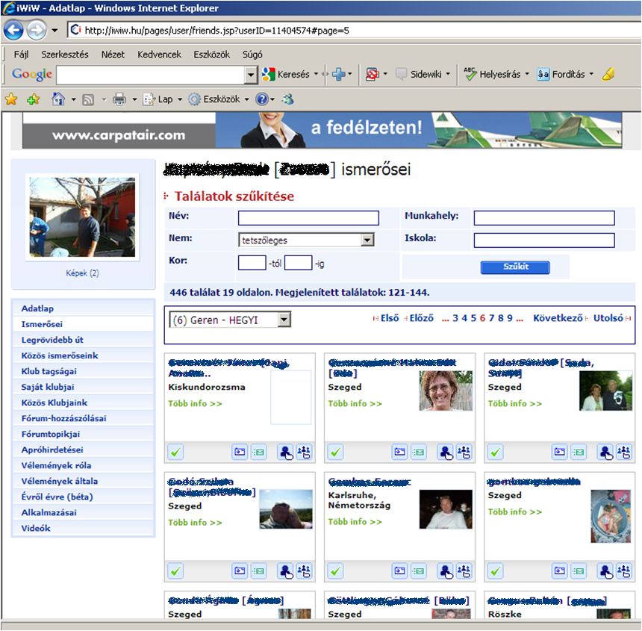
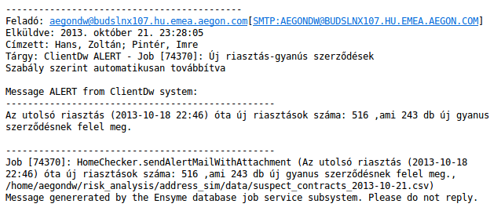
Predictive Claims Processing
Hungarian Insurance company cases
Rule generation (incl. social media)
Feature engineering
Machine learning & alert generation
Known fraud
Normal sample
Days since contract

Slide 14
3-4 transactions distance raise the flag

Slide 15
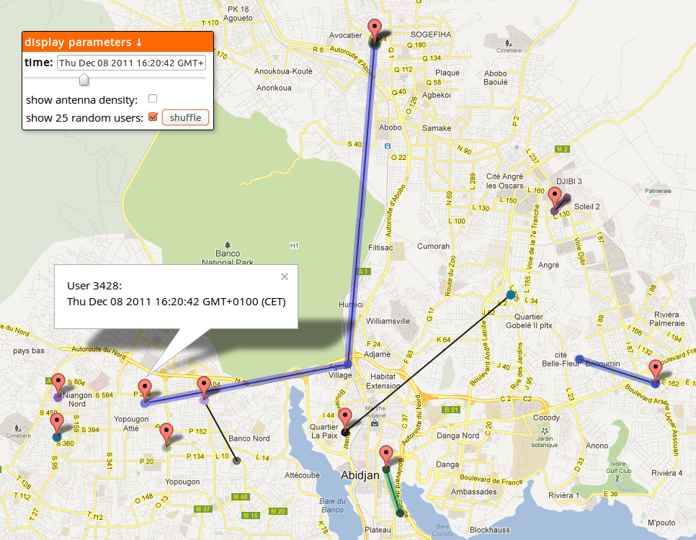
Need for Real Time Analytics

Slide 16
Software AND Human Latencies

Slide 17
Deep Analysis of Big Data is Key to Competitiveness

Slide 18
Data Science: Deep Analytics + Big Data

Slide 19
Data Scientist magic triangle
Domain Expertise (e.g., Industry 4.0, Medicine, Physics, Engineering, Energy, Logistics)
Mathematical Programming
Relational Algebra / SQL
Linear Algebra
Stochastic Gradient Descent
Application
Data Warehouse/OLAP
Error Estimation
NF² /XQuery
Active Sampling
Resource Management
Hardware Adaptation
Regression
Fault Tolerance
Monte Carlo
Data
Science
Memory Management
Statistics
Parallelization
Sketches
Scalability
ML
DM
Hashing
Machine Learning, Statistics, Data Analysis
Scalable Data Management
Memory Hierarchy
Convergence
Data Analysis Language
Decoupling
Compiler
Query Optimization
Iterative Algorithms
Indexing
Data Flow
Curse of Dimensionality
Control Flow
Real-Time

Slide 20
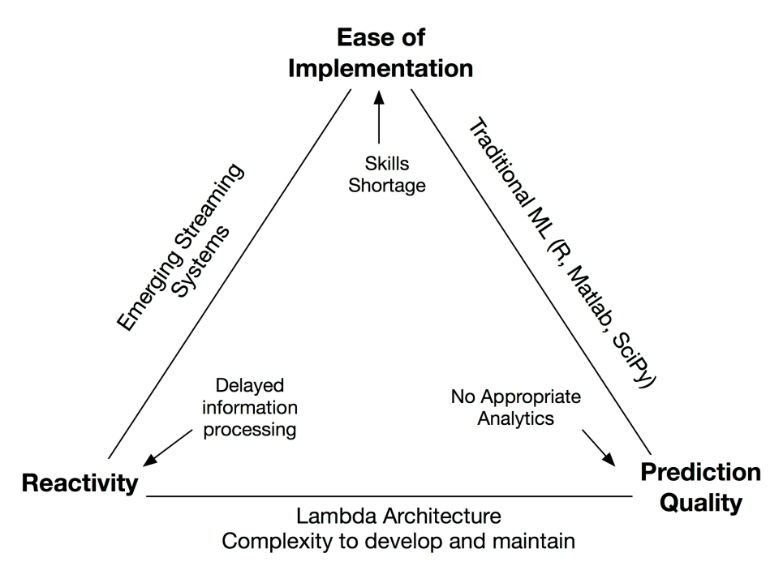
Apache Flink: the emerging European tool
TU Berlin / DFKI (DE)
SICS (SE)
SZTAKI (HU)

Slide 21
Data Scientist Supply Chain

Slide 22
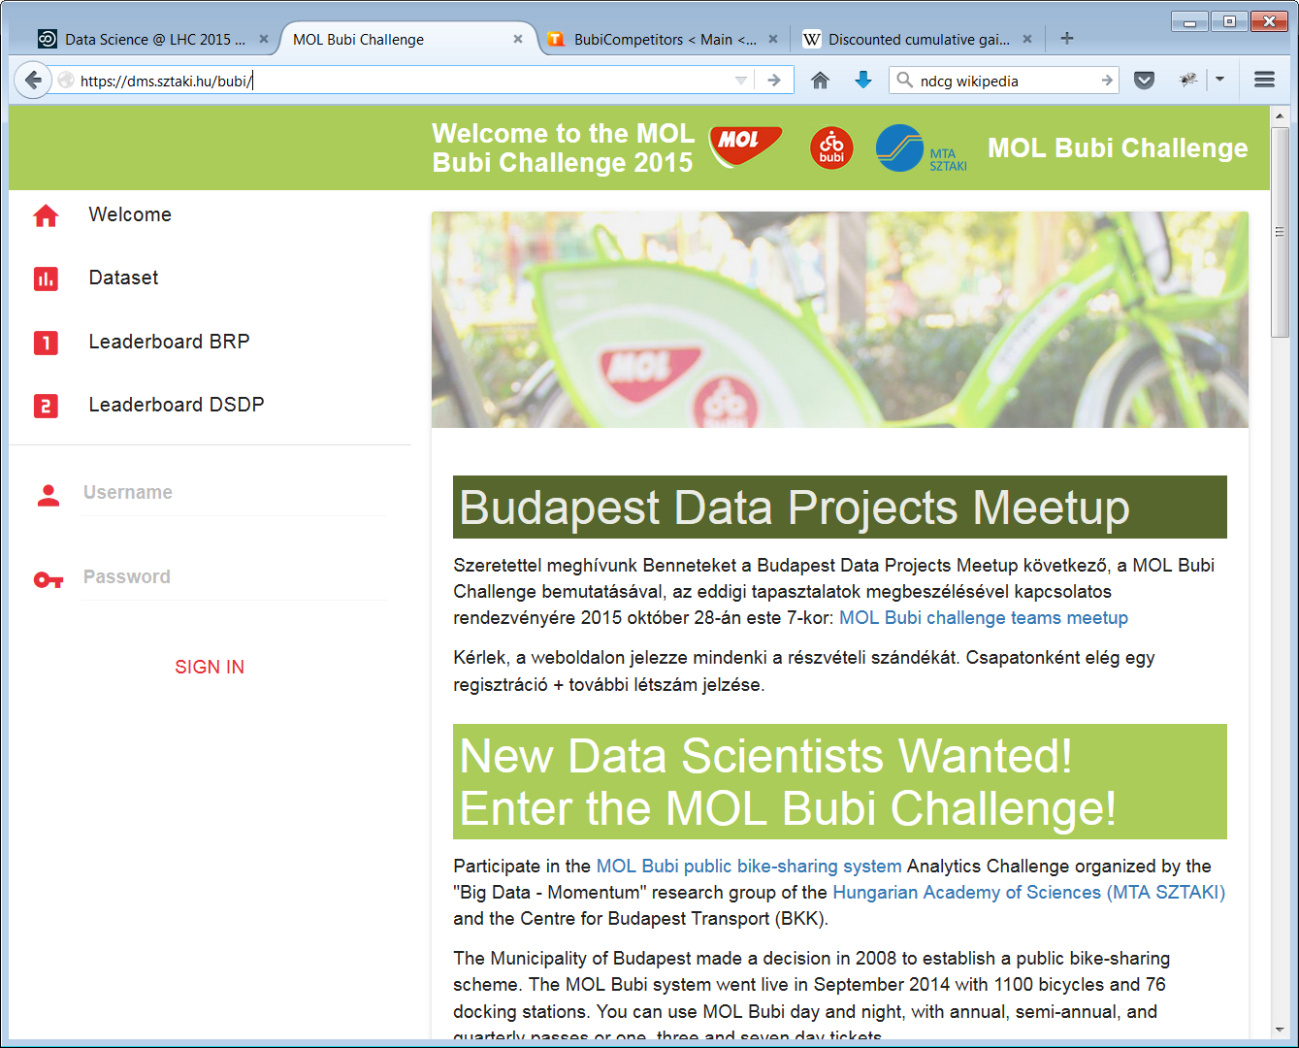

Slide 23
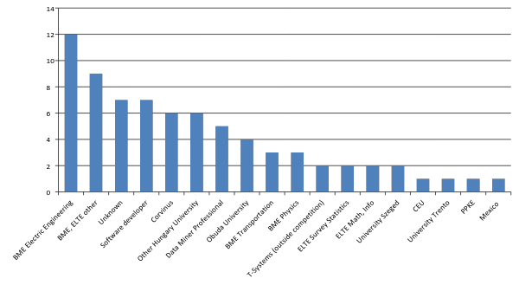
Registered teams - affiliation

Slide 24
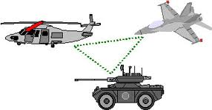
Extra Slide: Fully Distributed Modeling
Needs no central service – suitable for:
Ad hoc networks
Privacy requirements
Model delta updates are sent to peers
Results for applicability in:
Classification
Recommender Systems
Measurement
ΔQ
R ≈ P₁Q₁
ΔQ
R ≈ P₂(Q₂+ΔQ)

Slide 25
Conclusions
Software Latency
For data streaming solutions, we have to combine
Batch pre-computed models updated real time (lambda architecture)
Very low memory data approximation
Carefully selected database operations to optimize communication
Machine learning, prediction, classification made
Highly time sensitive, streaming
Fully distributed: each element learns by passing model error to peers
Human Latency
Shortage of Data Scientists worldwide
Needs training AND systems with reduced learning curve

